Slide 1
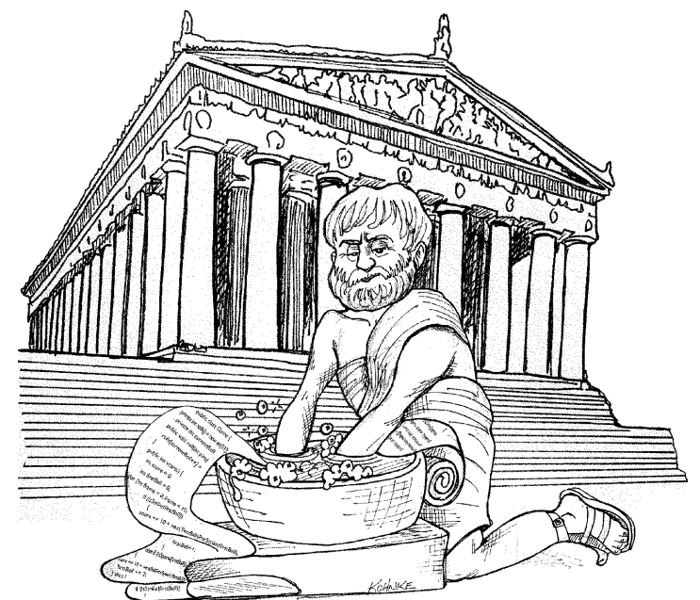
Clean Code
Notes:
You are attending this presentation two reasons. First, you are a programmer. Second, you want to be a better programmer. Good. We need better programmers.

Slide 2
Agenda
Introduction
Names
Review

Slide 3
Introduction

Slide 4
Clean code
" Have you ever been significantly impeded by bad code?
So - why did you write it?"

Slide 5
Why?
software rots over time
excuses
requirements changed (code should be easy to change)
tight schedules (bad code == more delay)
ratio of time spent reading vs. writing is over 10:1
unclean code costs you
harder to maintain (even by the original developer)
harder to add features
harder to change without introducing defects
can bring a company down

Slide 6
Why? (continued)
quick workarounds are debts for which you pay interest
temporary workarounds are not temporary most of the time
constant care and effort is needed to keep code clean

Slide 7
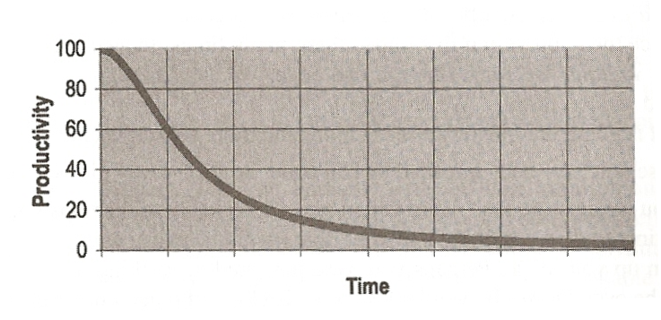
Productivity vs. time

Slide 8
Clean code
Any fool can write code that a computer can understand. Good programmers write code that humans can understand.
Martin Fowler

Slide 9
What is clean code
minimal dependencies
clean and minimal API
simple and direct (not cleaver!)
looks like it was written by someone who cares
Principle of least astonishment:
"You know you are working on clean code when each routine you read turns out to be pretty much what you expected. You can call it beautiful when the code also makes it look like the language was made for the problem" - Ward Cunningham

Slide 10
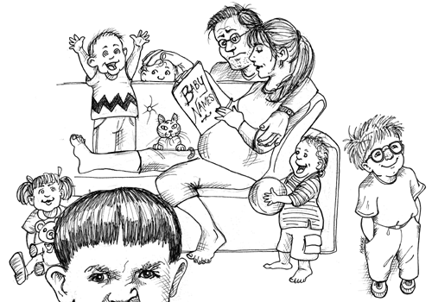
Names

Slide 11
Use Intention-Revealing Names
takes time but save more time
the name should say:
way it exist
what it does
how is used
if a name requires a comment then the name doesn't reveal its intent
int d; // elapsed time in days
Notes:
Choosing good names takes time but saves more time that it takes
The name of a variable, function, or class, should answer all the big questions. It should tell you why it exists, what it does, and how it is used.
If a name requires a comment, then the name does not reveal its intent. int d; // elapsed time in days

Slide 12
Use Intention-Revealing Names
public List<int[]> getThem() { List<int[]> list1 = new ArrayList<int[]>(); for (int[] x : theList) if (x[0] == 4) list1.add(x); return list1; }
Why is it hard to tell what this code is doing?
Notes:
There are no complex expressions. Spacing and indentation are reasonable. There are only three variables and two constants mentioned. There aren’t even any fancy classes or polymorphic methods, just a list of arrays (or so it seems).
To understand this code we need to know:
1. What kinds of things are in the list? 2. What is the signiﬁcance of the zeroth subscript of an item in the list? 3. What is the signiﬁcance of the value 4? 4. How would I use the list being returned?
The answers to these questions are not present in the code sample, but they could have been.

Slide 13
Use Intention-Revealing Names
Mine sweeper game improved version
public List<int[]> getFlaggedCells() { List<int[]> flaggedCells = new ArrayList<int[]>(); for (int[] cell : gameBoard) { if (cell[STATUS_VALUE] == FLAGGED) { flaggedCells.add(cell);
}
} return flaggedCells;
}

Slide 14
Use Intention-Revealing Names
Mine sweeper game final version
public List<Cell> getFlaggedCells() {
List<Cell> flaggedCells = new ArrayList<Cell>(); for (Cell cell : gameBoard.getCells()) { if (cell.isFlagged()) { flaggedCells.add(cell);
}
}
return flaggedCells;
}

Slide 15
Avoid Disinformation
Naming grouping of accounts as accountsList
better namings: accounts, accountGroup, etc.
accountsList is a good name only if is a variable of type java.util.List
Beware of using names which vary in small ways.
XYZControllerForEfficientHandlingOfStrings
XYZControllerForEfficientStorageOfStrings

Slide 16
Make Meaningful Distinctions
public static void copyChars(char a1[], char a2[]) { for (int i = 0; i < a1.length; i++) { a2[i] = a1[i]; }
}
a1 - source
a2 - destination

Slide 17
Make Meaningful Distinctions
Avoid noise words
Product
ProductInfo
ProductData

Slide 18
Use pronounceable names
genymdhms
generate date, year, month, day, hour, minute, and second
generateTimestamp
Don't use abbreviations
Mgr
Itrt
jis
FRSK

Slide 19
Use Searchable Names
for (int j=0; j<34; j++) { s += (t[j]*4)/5; }
OR
int realDaysPerIdealDay = 4; const int WORK_DAYS_PER_WEEK = 5; int sum = 0; for (int j=0; j < NUMBER_OF_TASKS; j++) { int realTaskDays = taskEstimate[j] * realDaysPerIdealDay;
int realTaskWeeks = (realdays / WORK_DAYS_PER_WEEK); sum += realTaskWeeks;
}

Slide 20
Class Names
noun or noun phrase
Customer, WikiPage, Account, AddressParser
avoid Manager, Processor, Data, Info
a class name should not be a verb

Slide 21
Method Names
verb or verb phrase
postPayment, deletePage, save
use accessors, mutators and predicates
get, set, is
don't be cute
don't use the name whack() to mean kill()
use solution domain names
AccountVisitor, UserFactory, JobQueue
use problem domain names

Slide 22
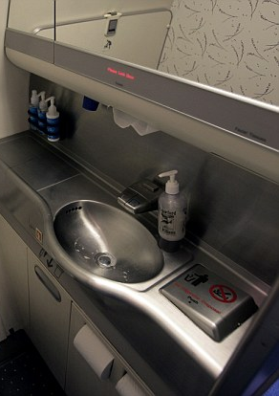
Conclusion
"As a courtesy to the next passenger, please clean the sync"
Notes:
I would say: "As a courtesy to the next developer, please clean the code"

